Slide 1
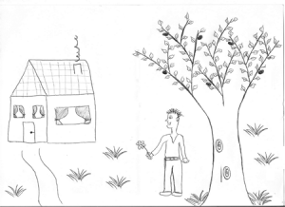
Humain
Nourriture : ____________________________________________________________________________________
Eau : ____________________________________________________________________________________
Espace : ____________________________________________________________________________________
Abri : ____________________________________________________________________________________

Slide 2
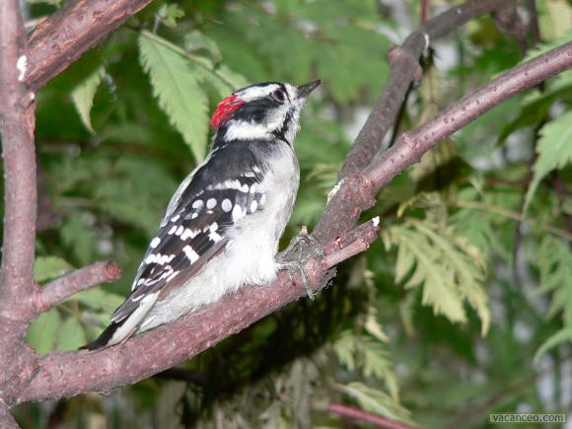
Pic-bois
Nourriture : ____________________________________________________________________________________
Eau : ____________________________________________________________________________________
Espace : ____________________________________________________________________________________
Abri : ____________________________________________________________________________________

Slide 3
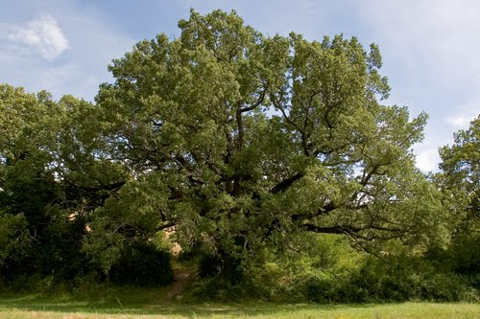
Chêne
Nourriture : ____________________________________________________________________________________
Eau : ____________________________________________________________________________________
Espace : ____________________________________________________________________________________
Abri : ____________________________________________________________________________________

Slide 4
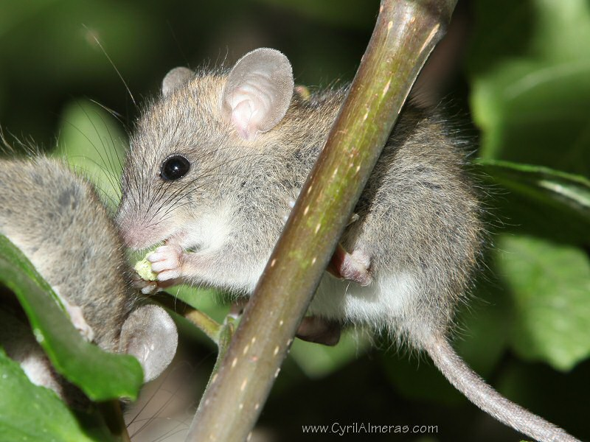
Souris
Nourriture : ____________________________________________________________________________________
Eau : ____________________________________________________________________________________
Espace : ____________________________________________________________________________________
Abri : ____________________________________________________________________________________

Slide 5
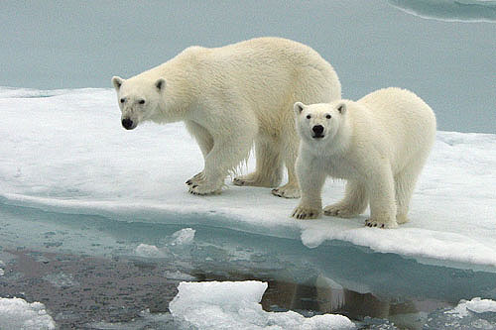
Ours blanc
Nourriture : ____________________________________________________________________________________
Eau : ____________________________________________________________________________________
Espace : ____________________________________________________________________________________
Abri : ____________________________________________________________________________________

Slide 6
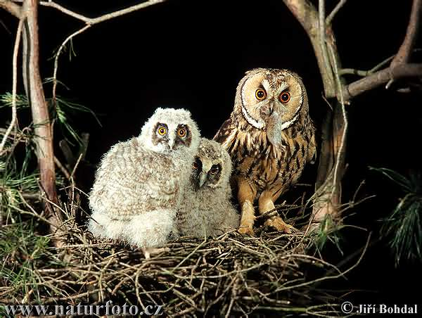
Hibou
Nourriture : ____________________________________________________________________________________
Eau : ____________________________________________________________________________________
Espace : ____________________________________________________________________________________
Abri : ____________________________________________________________________________________

Slide 7
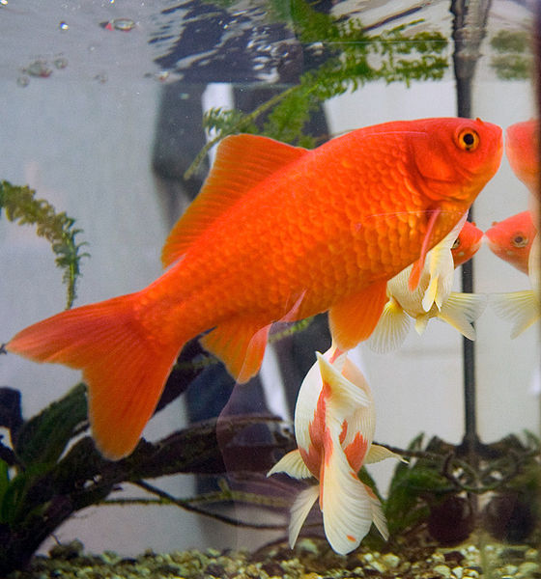
Poisson rouge
Nourriture : ____________________________________________________________________________________
Eau : ____________________________________________________________________________________
Espace : ____________________________________________________________________________________
Abri : ____________________________________________________________________________________

Slide 8
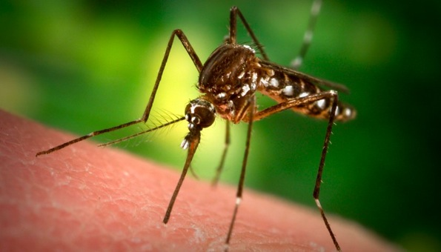
Moustique
Nourriture : ____________________________________________________________________________________
Eau : ____________________________________________________________________________________
Espace : ____________________________________________________________________________________
Abri : ____________________________________________________________________________________

Slide 9
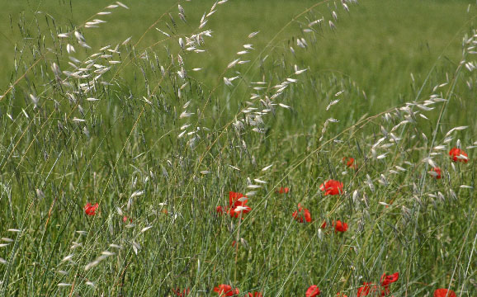
Folle avoine
Nourriture : ____________________________________________________________________________________
Eau : ____________________________________________________________________________________
Espace : ____________________________________________________________________________________
Abri : ____________________________________________________________________________________

Slide 10
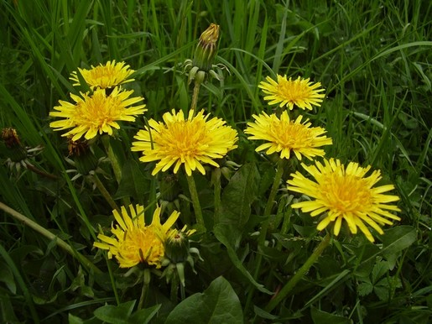
Pissenlit
Nourriture : ____________________________________________________________________________________
Eau : ____________________________________________________________________________________
Espace : ____________________________________________________________________________________
Abri : ____________________________________________________________________________________

Slide 11
Baleine
Nourriture : ____________________________________________________________________________________
Eau : ____________________________________________________________________________________
Espace : ____________________________________________________________________________________
Abri : ____________________________________________________________________________________

Slide 12
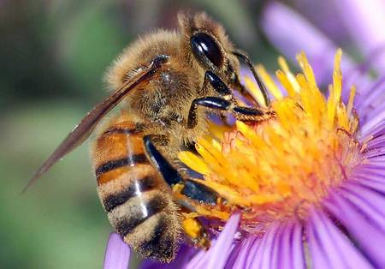
Abeille
Nourriture : ____________________________________________________________________________________
Eau : ____________________________________________________________________________________
Espace : ____________________________________________________________________________________
Abri : ____________________________________________________________________________________

Slide 13
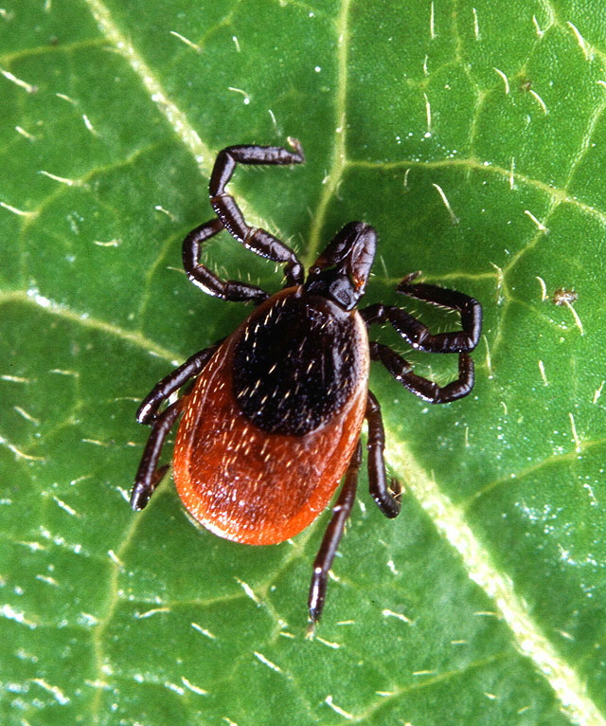
Pou de bois
Nourriture : ____________________________________________________________________________________
Eau : ____________________________________________________________________________________
Espace : ____________________________________________________________________________________
Abri : ____________________________________________________________________________________

Slide 14
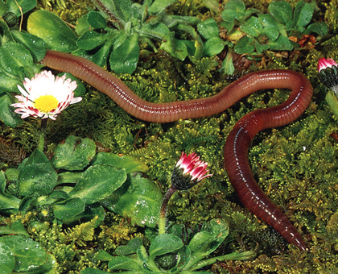
Ver de terre
Nourriture : ____________________________________________________________________________________
Eau : ____________________________________________________________________________________
Espace : ____________________________________________________________________________________
Abri : ____________________________________________________________________________________

Slide 15
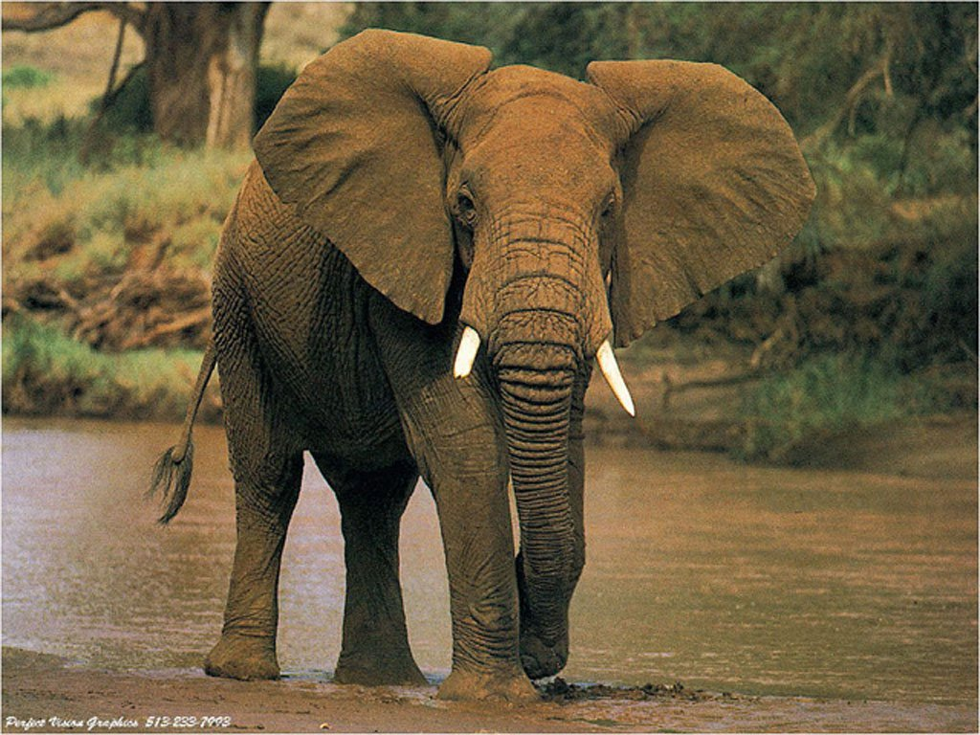
Éléphant
Nourriture : ____________________________________________________________________________________
Eau : ____________________________________________________________________________________
Espace : ____________________________________________________________________________________
Abri : ____________________________________________________________________________________

Slide 16
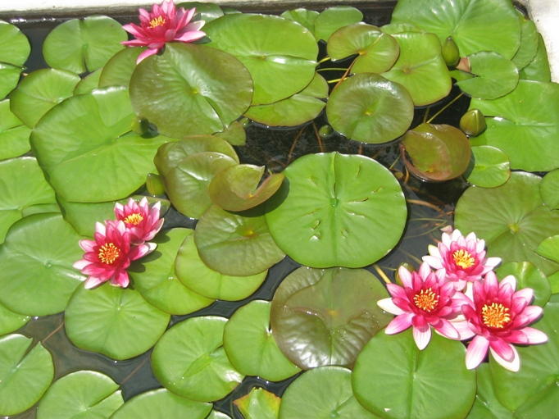
Nénuphar
Nourriture : ____________________________________________________________________________________
Eau : ____________________________________________________________________________________
Espace : ____________________________________________________________________________________
Abri : ____________________________________________________________________________________

